Slide 1
PowerBi Projects

Slide 2
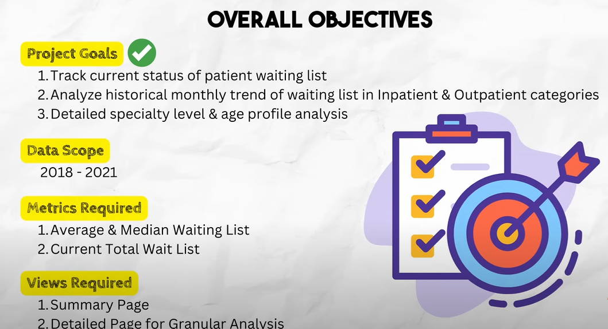

Slide 3
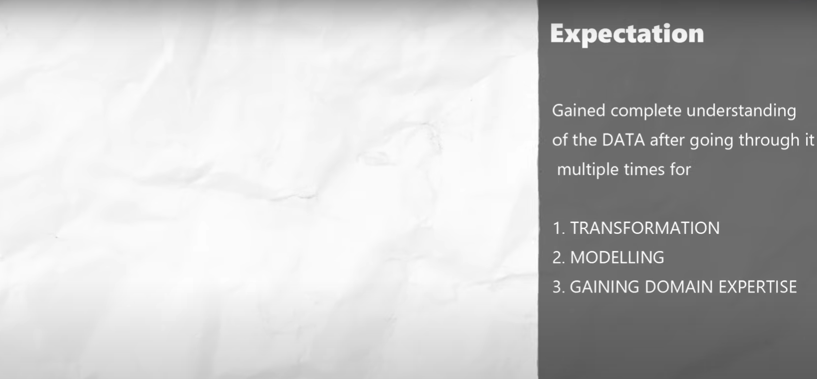
DESIGN BLUEPRINT

Slide 4
